Slide 1


[Github Intro]

Slide 2
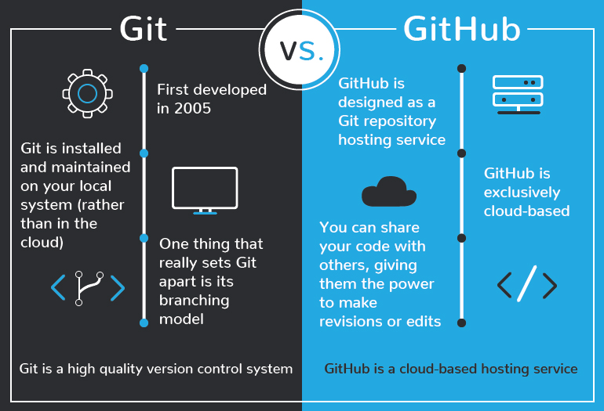
Difference between Git and Github

Slide 3
What is repository?
A repository contains all of your project's files and each file's revision history. You can discuss and manage your project's work within the repository.

Slide 4

Some tips you must know…

Slide 5
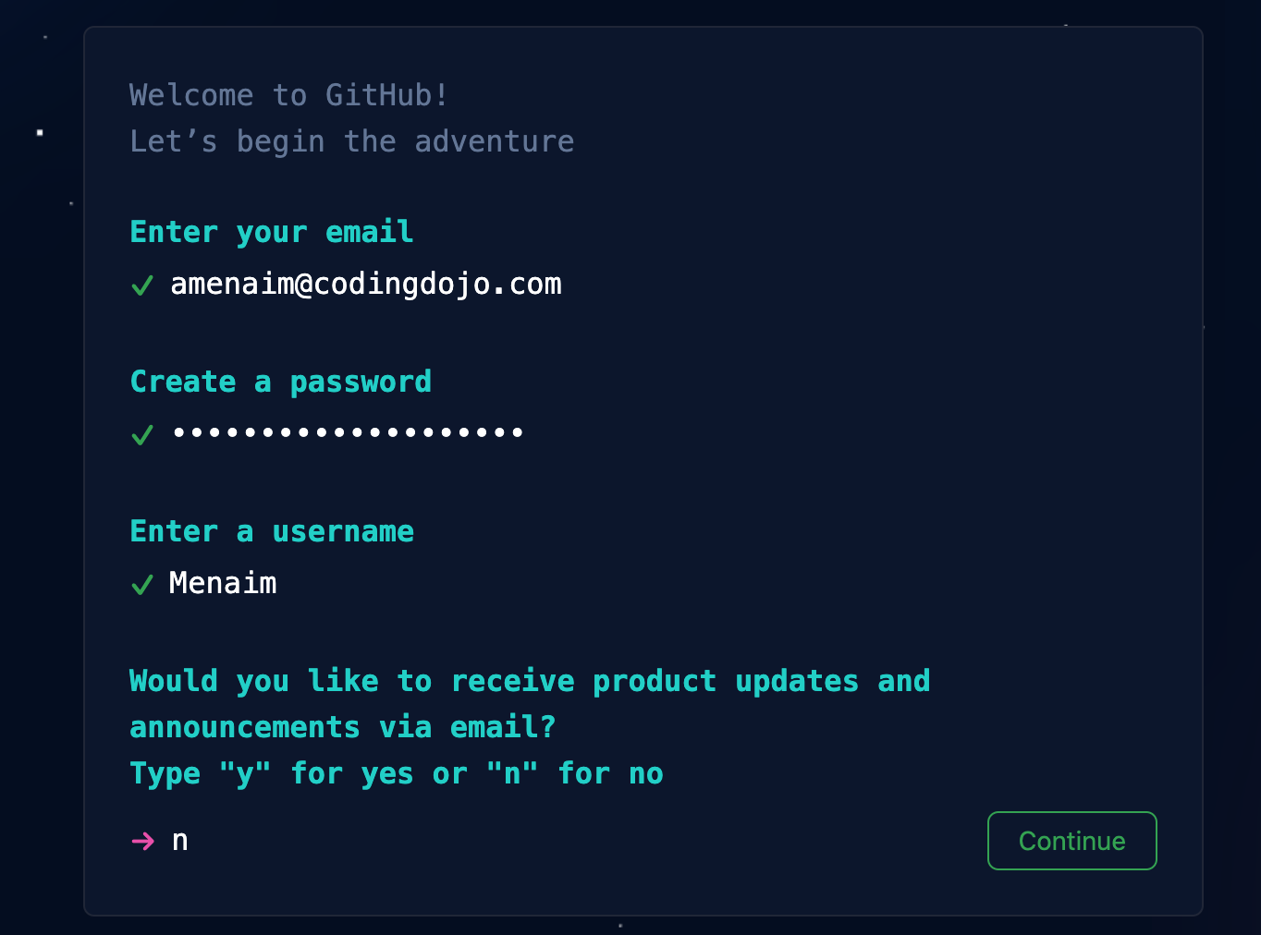
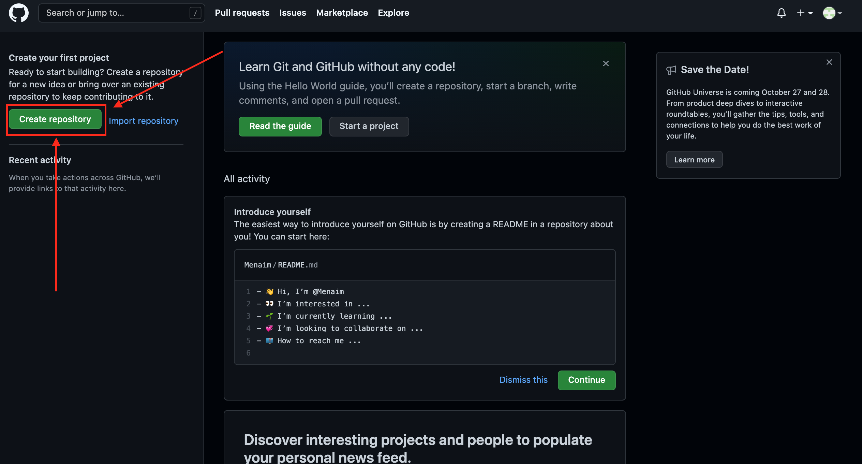
Signup & Login
1- Sign up from here
2- Fill your data
3- Yopy!! You are in the dashboard now
4- Click on create repository

Slide 6
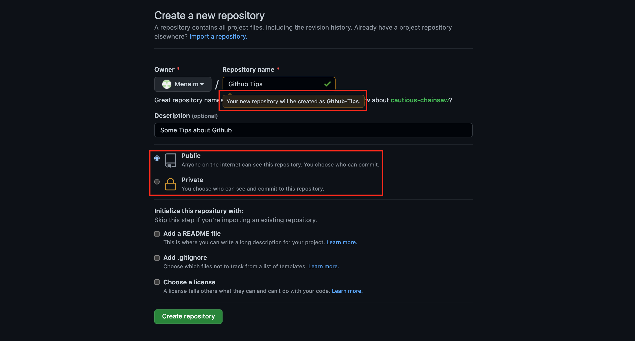
Creating Repo Tips
1- Repository name can’t have spaces
2- You can make it private and share it with your team only “Recommended for private work
3- You can make it public for anyone to see

Slide 7
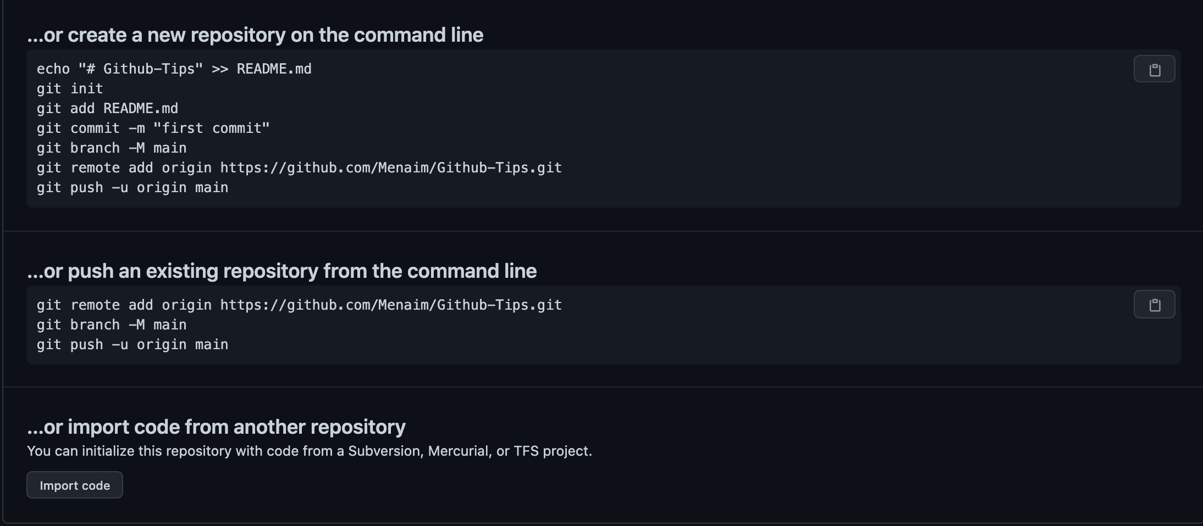
Creating Repo Tips Cont.
Don’t worry !! Every single line will be explained
1- Once you click on create you will see this screenshot…

Slide 8
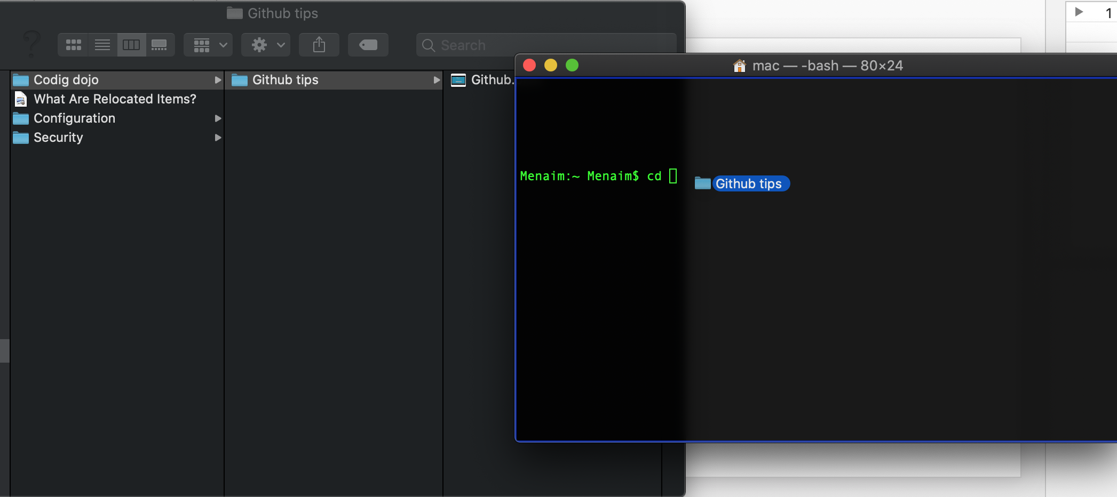
Creating Repo Tips Cont.
1- You need to access the file in your PC by doing this:
1.1 Open terminal
1.2 Type cd
1.3 Drag the folder

Slide 9
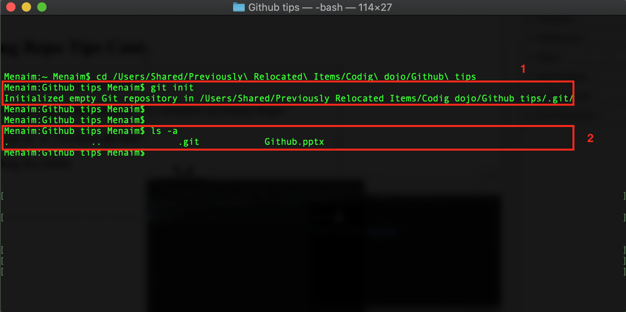
Creating Repo Tips Cont.
Now you have an access on the file:
1. Write git init on the terminal “To initialize an empty Repo”
2. Type ls –a “To show all files”

Slide 10
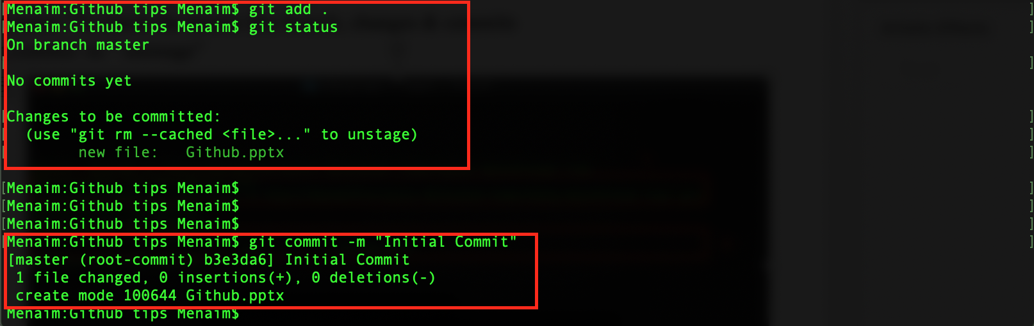
Commit to Repo
git add . “To add everything in your repo”
git status ”To check the details like branch, changes & commits
git commit -m “ message”

Slide 11
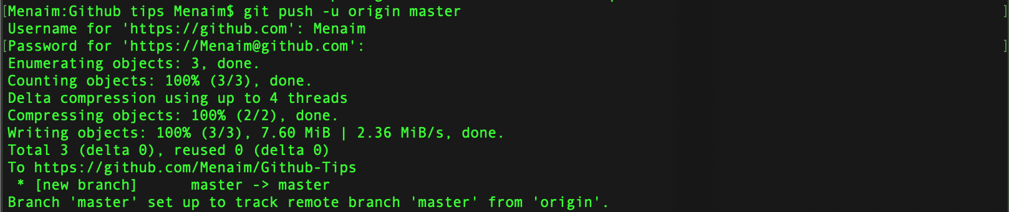
Commit to Repo Cont.
Go to github and copy the link for the repo you have created before
git remote add origin “The link”
git push -u origin master “It may require you to enter your username and password”

Slide 12
Commit to Repo Cont.
Now you can check your repo and you will find it updated !!
- Tips needed to be noted while committing:
1- Most of the time you are team player, so you need to create your own branch.
2- Never push to the master as I did in the previous slide.
3- Always be sure that you are pushing the specific branch you have created.

Slide 13
Create branch
1- To create a branch and auto switch to it use “git checkout -b branchName”
2- You can see your branches and the used one by using “git branch”
3- You can create only branch without switching to it “git branch branchName”
4- Switching to a branch after creating it “git checkout branchName”
5- Rename branch “git branch –m newName”
6- To delete a branch “git branch -d branchName” -d & -D Rule

Slide 14
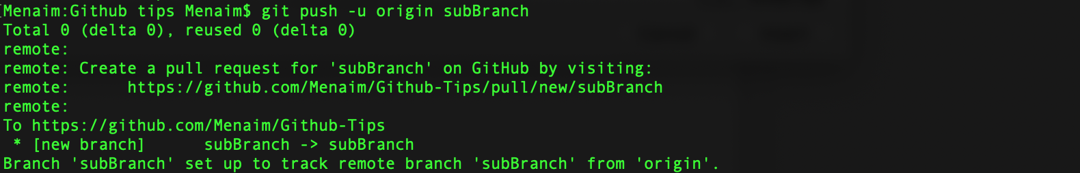
Create branch Cont.
1- To push changes onto a new branch on GitHub, you'll want to run git push origin yourbranchname. GitHub will automatically create the branch for you on the remote repository
2- Now you can check github, you will find two branches instead of one

Slide 15
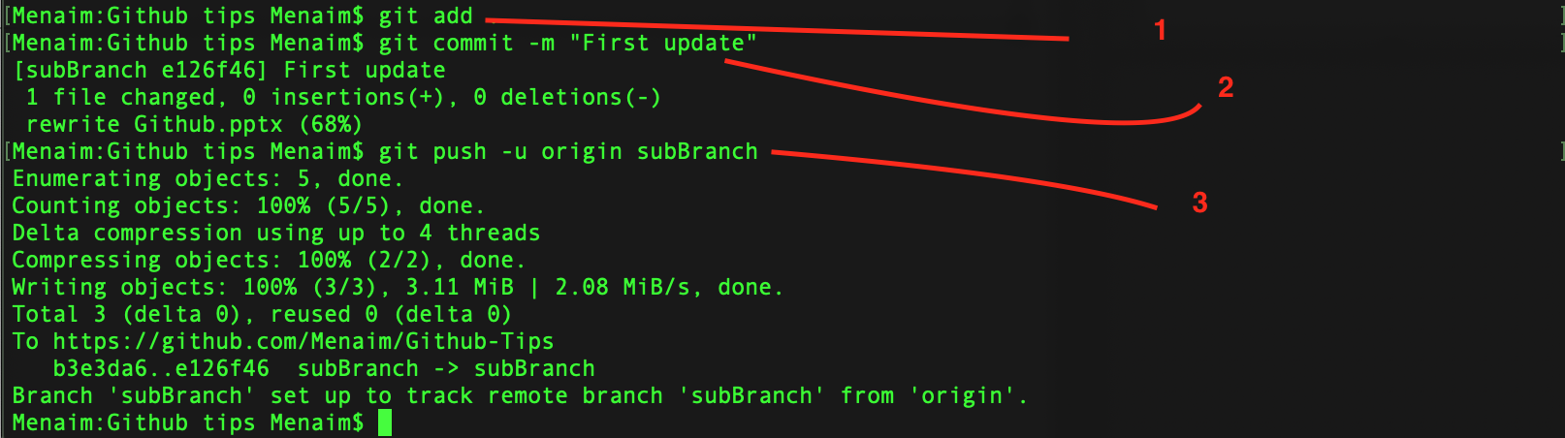
Commit to the new branch
- Of course your code or whatever is changed by the time so it needs to be updated by the time so I have retyped each command to be able to do this:

Slide 16
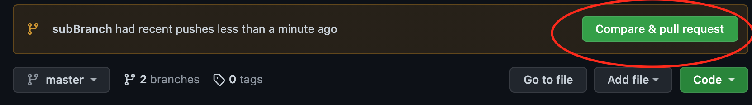
Pull Request
- Once pushing is done, Github will offer you to compare and make pull request

Slide 17
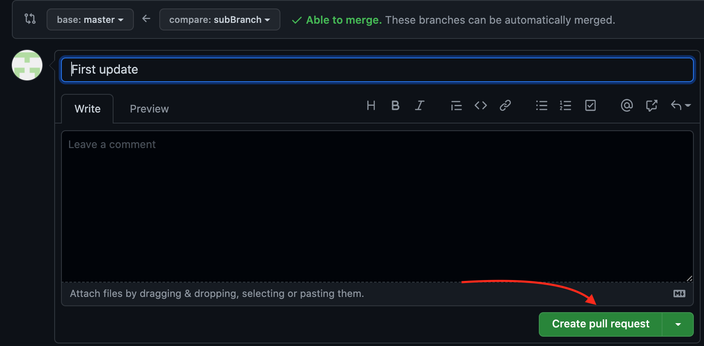
Pull Request Cont.
- Now you can create pull request to be able to merge files and get the new one:

Slide 18
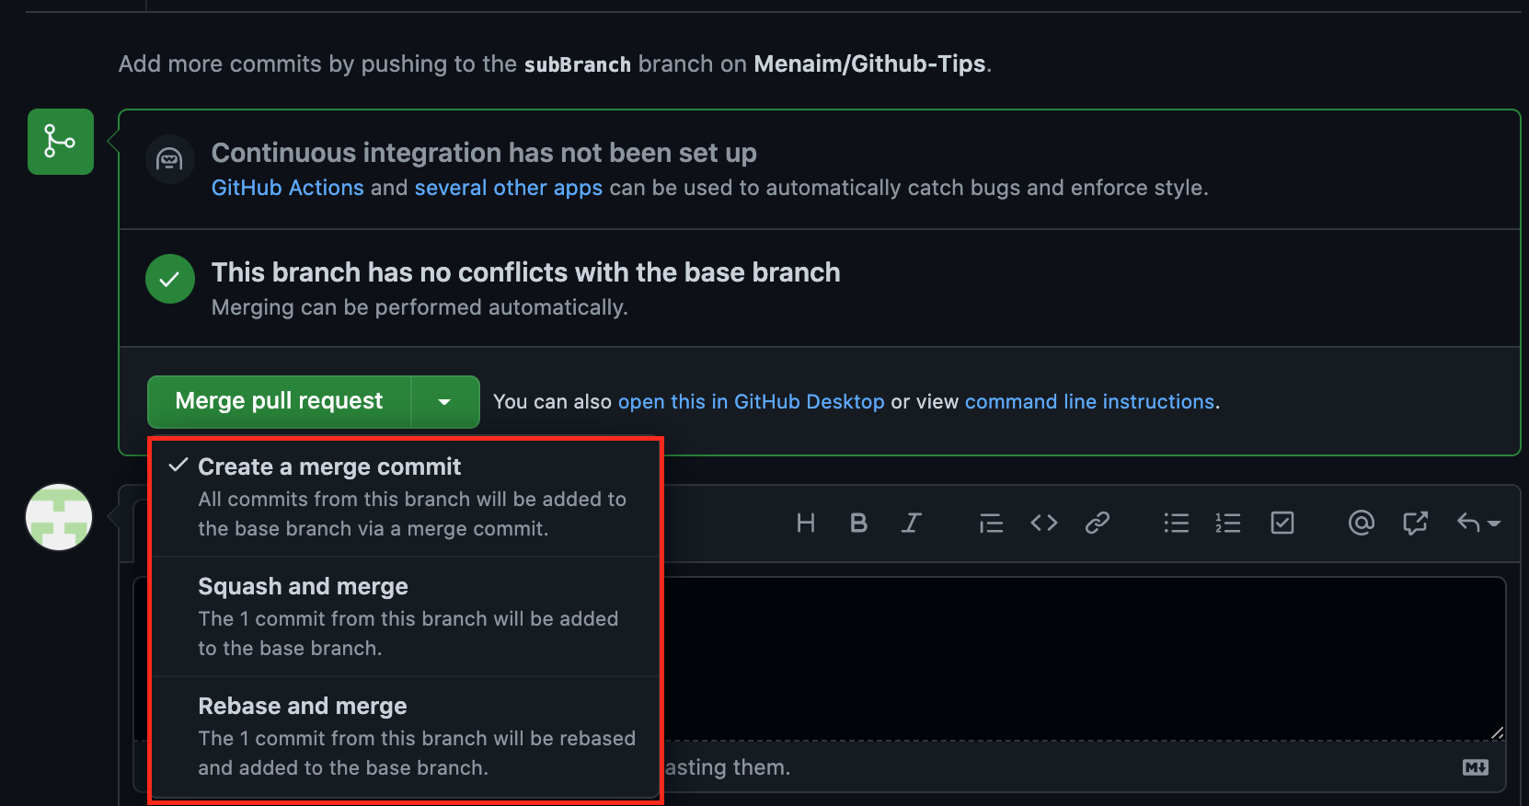
Pull Request Cont.
- All you need to do is to choose one depending on your project or to just click on “Merge pull request”

Slide 19
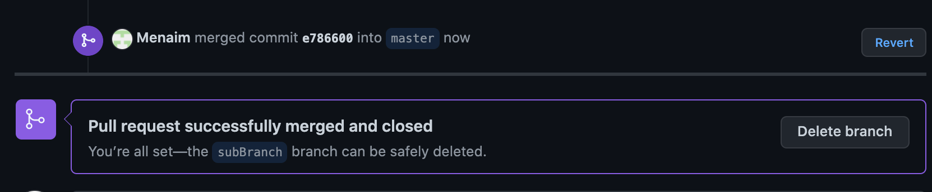
Pull Request Cont.
Now I have merged it and I can delete the unused branch…
Note that you can do it through terminal using this:
git checkout master
git merge subBranch
git branch -d subBranch

Slide 20


Windows process

Slide 21
Install Git & Git bash on windows
- Navigate to the latest Git for Windows installer and download the latest version.
- Once the installer has started, follow the instructions as provided in the Git Setup wizard screen until the installation is complete.
- Open the windows command prompt (or Git Bash if you selected not to use the standard Git Windows Command Prompt during the Git installation).
- Type git version to verify Git was installed.
Note: git-scm is a popular and recommended resource for downloading Git for Windows. The advantage of downloading Git from git-scm is that your download automatically starts with the latest version of Git included with the recommended command prompt, Git Bash . The download source is the same Git for Windows installer as referenced in the steps above.

Slide 22
Errors you may face…

Slide 23
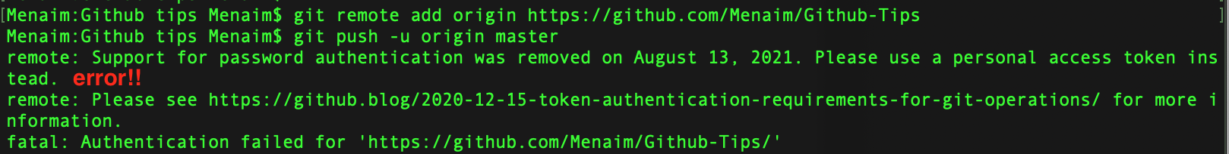
Commit to Repo
Go to github and copy the link for the repo you have created before
git remote add origin “The link”
git push -u origin master – I’ve face an error here:
Let’s solve it…

Slide 24
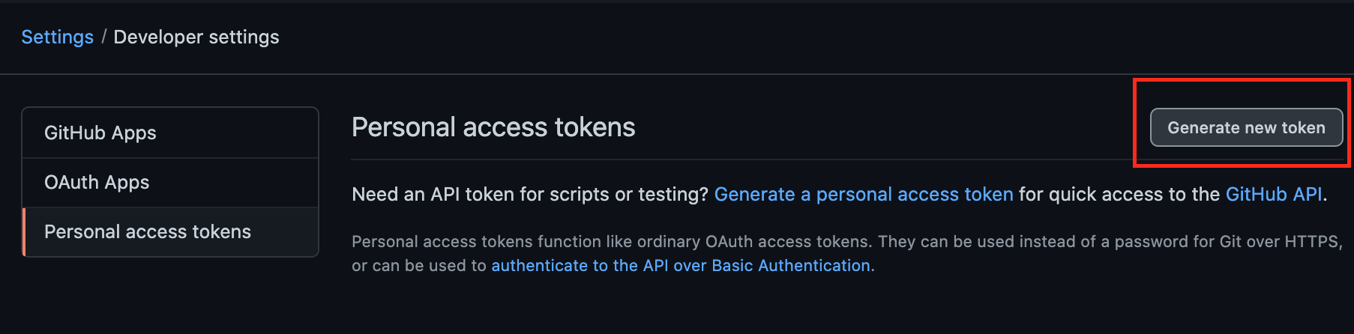
Solving Error For Mac users
Go to this link to generate a token here
Click on generate token like the image
Now search for an app in your Mac, named Keychain Access.
Search for github.com (if there are multiple GitHub logins then choose Kind: Internet password), double-click it.
Click on show password, then enter your Mac's password and hit Enter.
Password should be visible by now. Now, just paste the token you generated in step 2 and click Save changes

Slide 25
Solving Error For Windows users
Follow the same 1,2 steps in the previous slide
Search for an application in your Windows OS, named Credential Manager → then Windows Credentials.
Search for github.com and edit the password with the token you have generated on GitHub. Now enjoy!

Slide 26
Give access for collaborators
Who are collaborators and what can they access !?
Collaborator access for a repository owned by a user account
Collaborators on a personal repository can pull (read) the contents of the repository and push (write) changes to the repository.
Note: In a private repository, repository owners can only grant write access to collaborators.

Slide 27
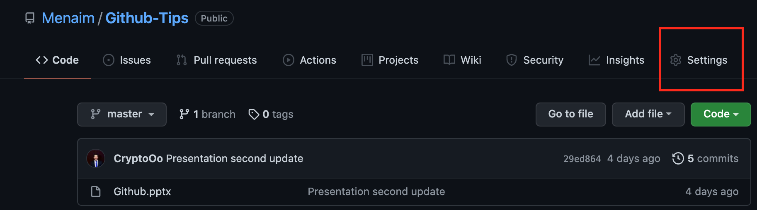
Give access for collaborators
On GitHub, navigate to the main page of the repository.
Under your repository name, click Settings.

Slide 28
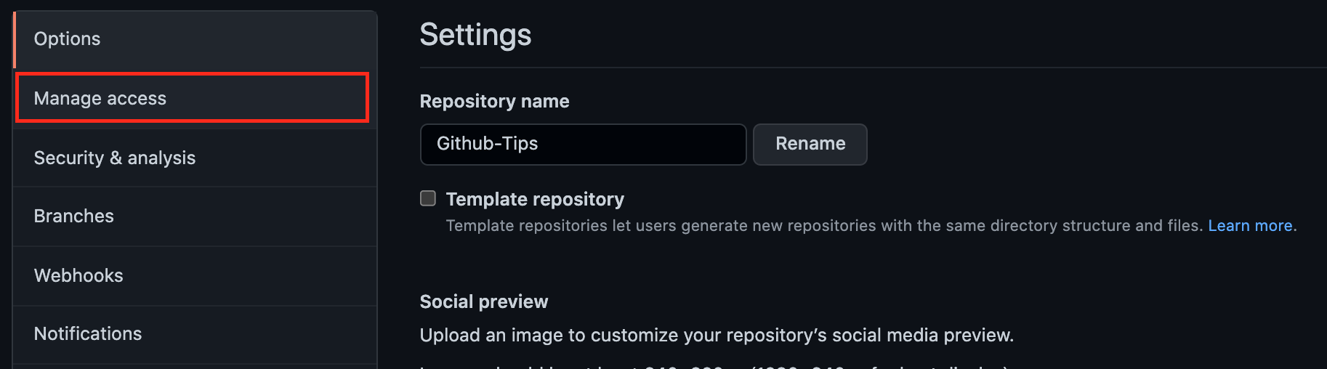
Give access for collaborators Cont.
In the left sidebar, click Manage access.

Slide 29
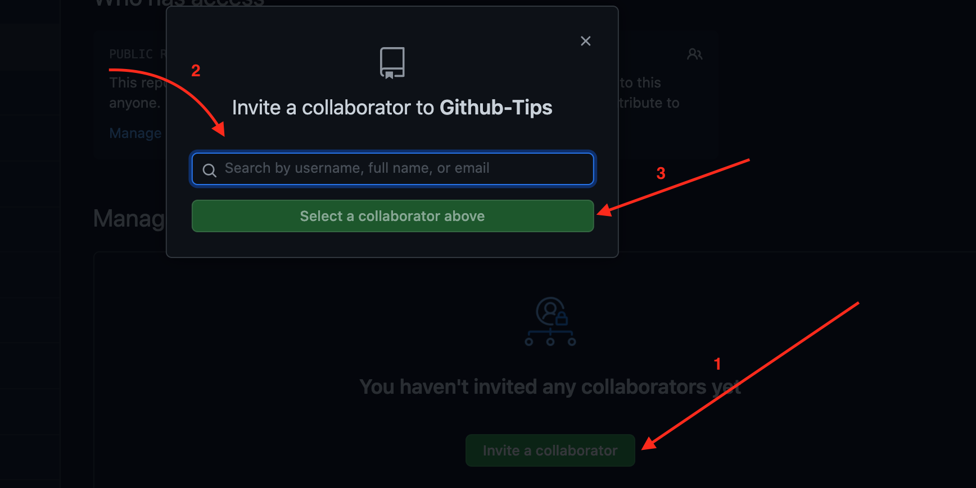
Give access for collaborators Cont.
It may require you to enter your password
click Invite collaborator
In the search field, start typing the name of person you want to invite, then click a name in the list of matches.

Slide 30
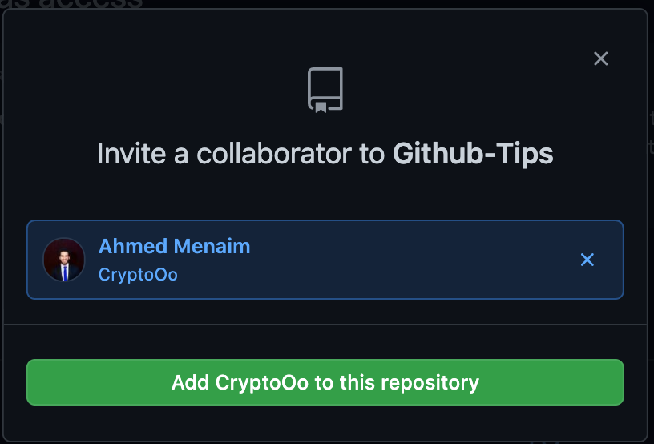
Give access for collaborators Cont.
It can appear in the search like the image below:

Slide 31
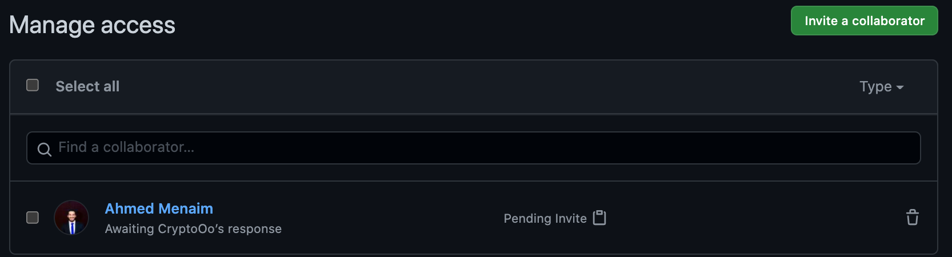
Give access for collaborators Cont.
Finally, You can found invitations in the bottom of the screen…

Slide 32
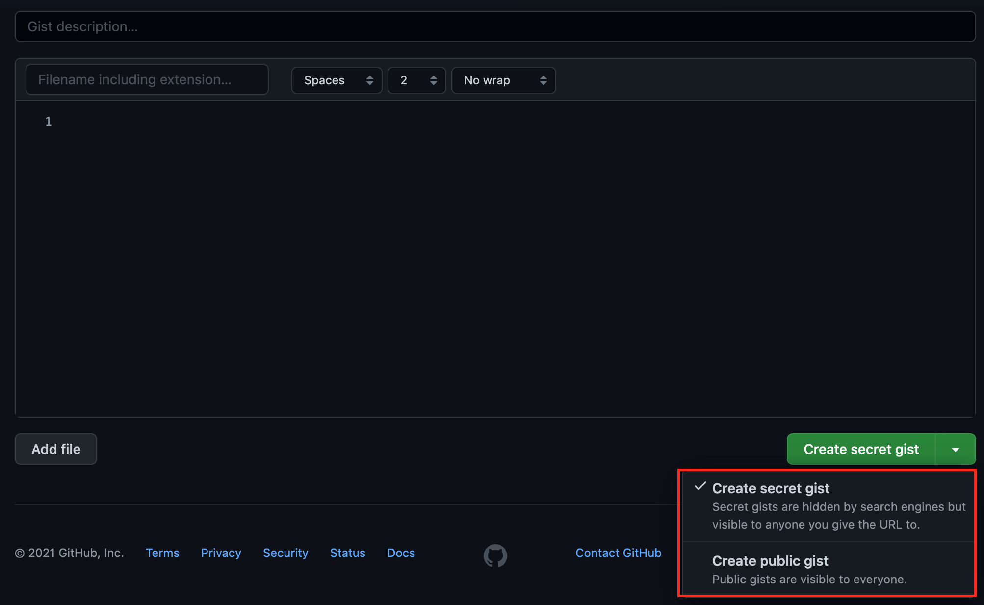
Github Gists
1- You can go through this using the link
2- You can make it secret or public.

Slide 33
Github Gists Cont.
1- You can go through this using the link
2- You can make it secret or public.

Slide 34
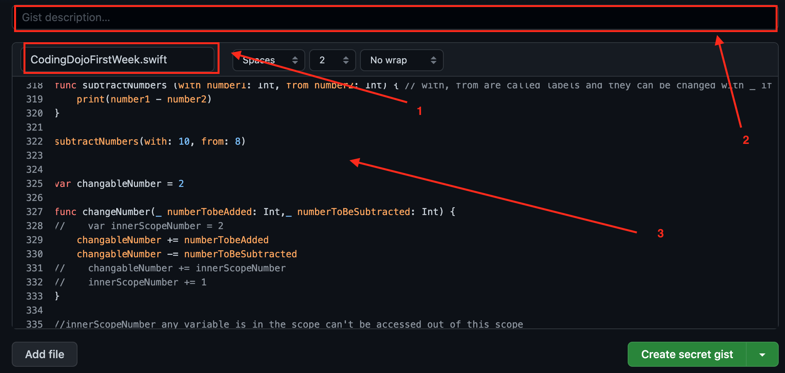
Github Gists Cont.
1- You can give it a name with extension “.swift”
2- You have the option to give description or not
3- You can copy paste your code.

Slide 35
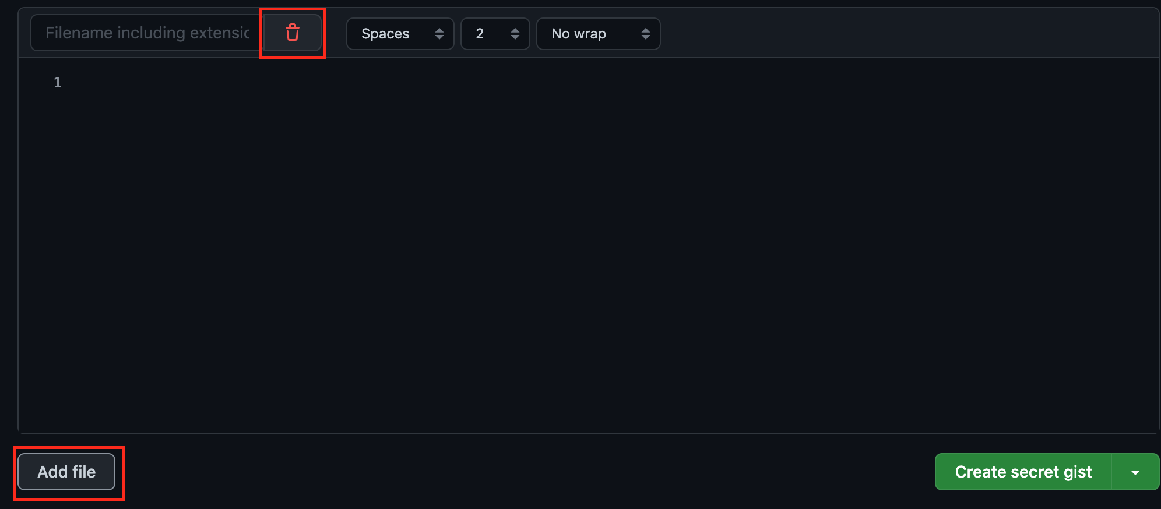
Github Gists Cont.
1- You can add another file
2- Your gist must have at least one file
3- You can delete it normally

Slide 36
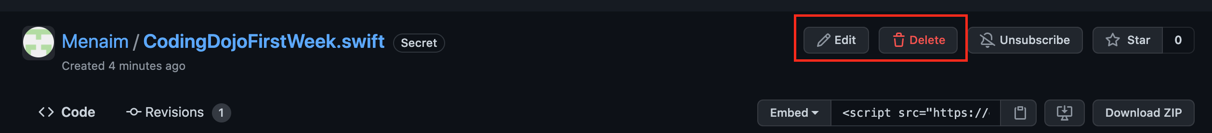
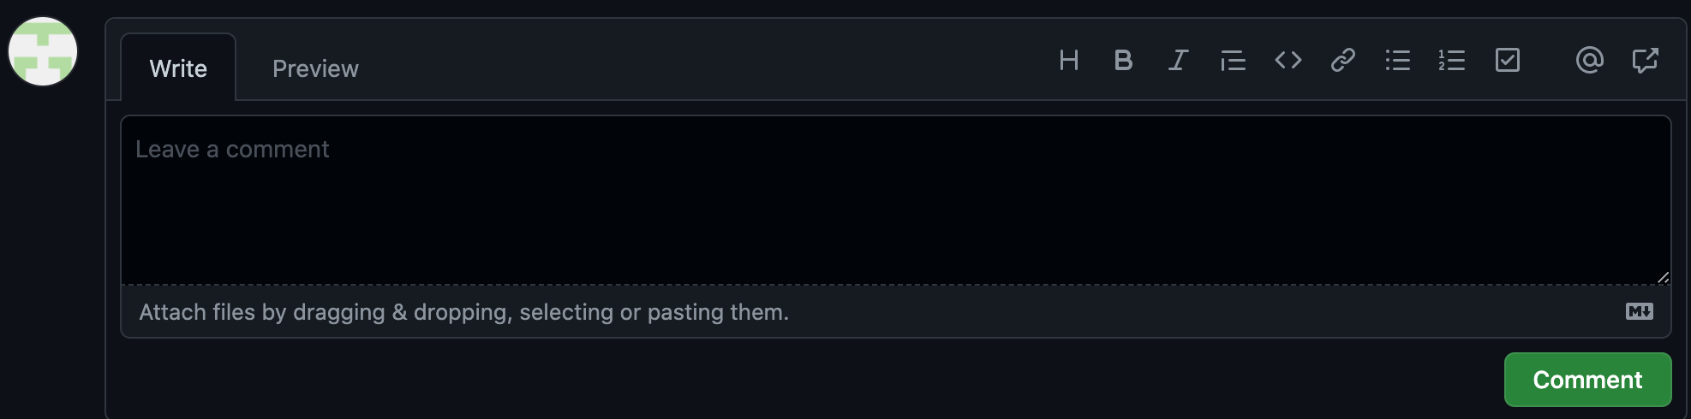
Github Gists Cont.
1- Once you create it even as a secret one, you can share it with anyone using the link
2- You can delete or edit it
3- If anyone has an account, and link shared with him/her he can comment and start discussing it with you

Slide 37
Thank you

